Slide 1
ISP152 – Topic 1: Network Fundamentals
1.1 Introduction
1.2 Network topologies, hardware and software.
1.3 The functions performed by different types of servers on a network.
1.4 The OSI model and the IEEE 802 standards.

Slide 2
Module Outcomes
Demonstrate an understanding of the Open Systems Interconnection (OSI) model and common network architectures.
Identify the key hardware and software components found in computer networks.
Participate in the implementation of the basic principles that underpin the protection of information assets (identification, authentication, etc).
Identify the different stages of the operations security process, and the activities that occur within each stage.
Identify common threats affecting information security at the human level, the physical level, the network level and the application level; and outline preventative measures that can be used to eliminate or manage these threats.

Slide 3
(1.1) Introduction
In this topic, you will gain knowledge in the following areas:
1.2 Network topologies, hardware and software.
1.3 The functions performed by different types of servers on a network.
1.4 The OSI model and the IEEE 802 standards.

Slide 4
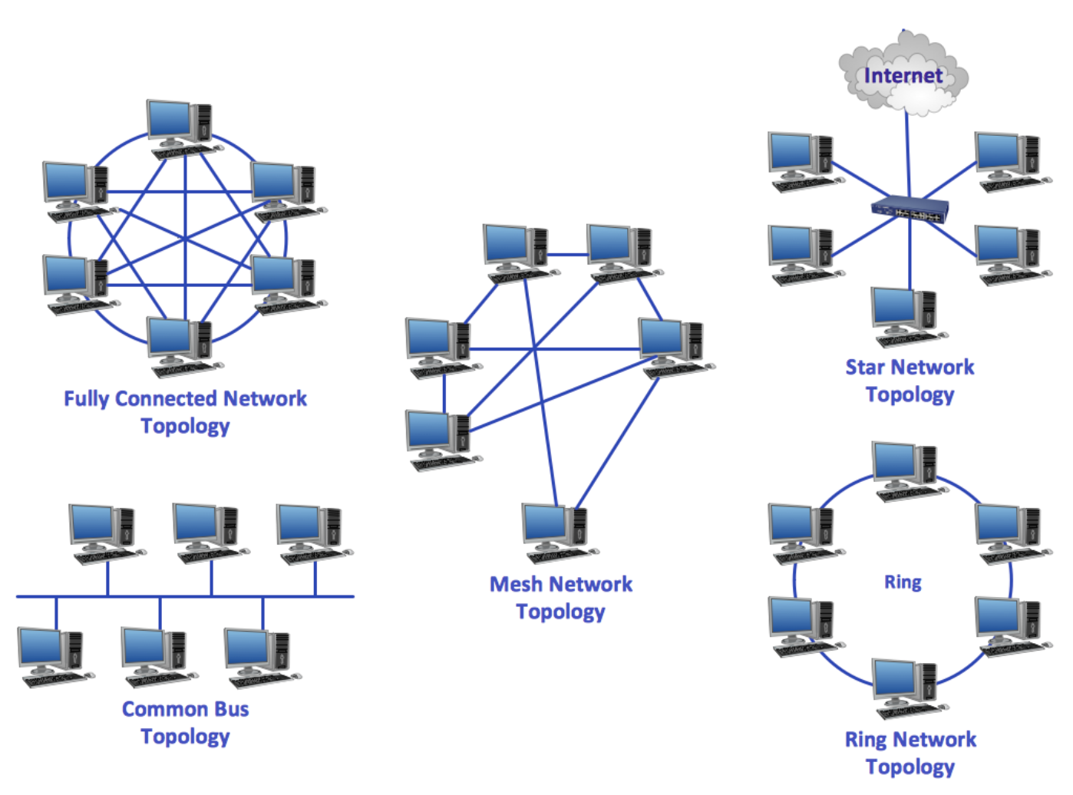
(1.2) Network topologies, hardware and software
1.2.1 Network topologies
Personal area networks (PANs) are generally limited to home use.
Local area networks (LANs) usually serve an organisation or business.
Metropolitan area networks (MANs) use multiple interconnected LANs to provide shared access to resources within a city or metro.

Slide 5

(1.2) Network topologies, hardware and software
1.2.1 Network topologies
Wide area networks (WANs) connect multiple PANs, LANs and MANs across a wide geographical area. The Internet is an example of a WAN.
An intranet is an organisational network used for internal communication with and between employees.
An extranet supports external communication with business partners, suppliers and customers.

Slide 6
(1.2) Network topologies, hardware and software
Activity
Watch the following video:
Title: Network Types: LAN, WAN, PAN, CAN, MAN, SAN, WLAN.
Link: https://www.youtube.com/watch?v=4_zSIXb7tLQ
Time allocation: 04:55

Slide 7
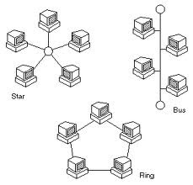
(1.2) Network topologies, hardware and software
A bus topology is based on a single ‘backbone’ (usually of coaxial cable), to which computers, printers and other network devices are connected in series.
In a ring topology, the network cable forms a closed circle to which computers, printers and other network devices are connected.
In a star topology, computers, printers and other network devices are each connected independently to a central server. An extended star topology uses a bus connection to link the servers of two or more star topologies.

Slide 8
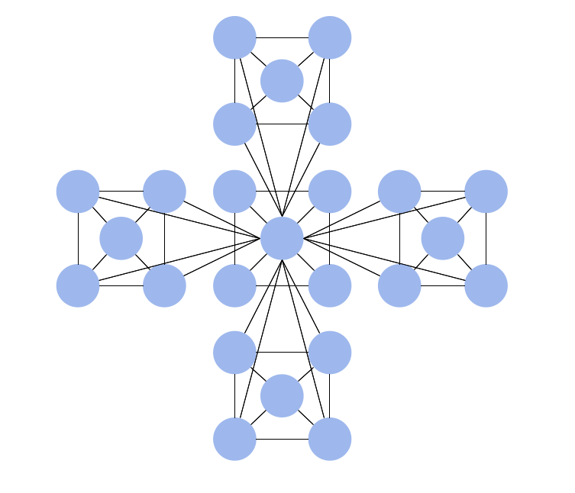
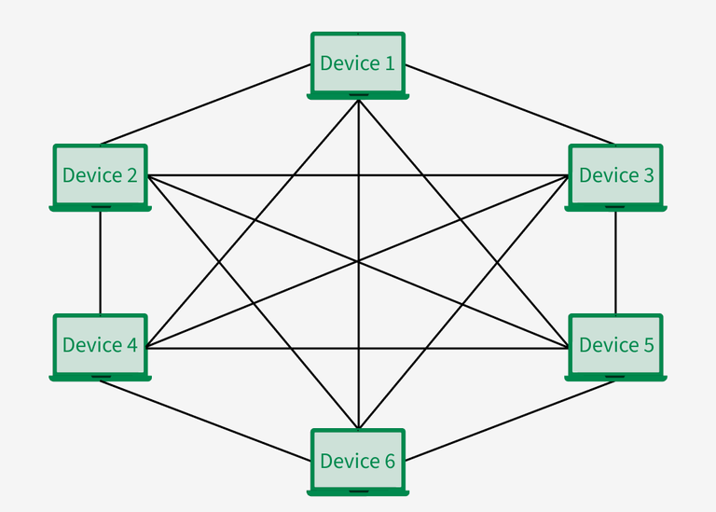
(1.2) Network topologies, hardware and software
A hierarchical topology uses a combination of twisted pair cables and optical fibre to combine multiple star and bus topologies encompassing at least three hierarchical levels.
In a mesh topology, each computer is connected to every other computer that forms the network. A mesh topology usually interconnects multiple LANs to create a WAN.
The logical topology of a network reflects the logical paths that carry signals from one computer to another, or from one network node to another.

Slide 9
(1.2) Network topologies, hardware and software
Activity
Watch the following video:
Title: Network Topologies (Star, Bus, Ring, Mesh, Ad hoc, Infrastructure, & Wireless Mesh Topology).
Link: https://www.youtube.com/watch?v=zbqrNg4C98U&t=4s
Discuss this with your fellow students and lecturer.
Time allocation: 08:57

Slide 10
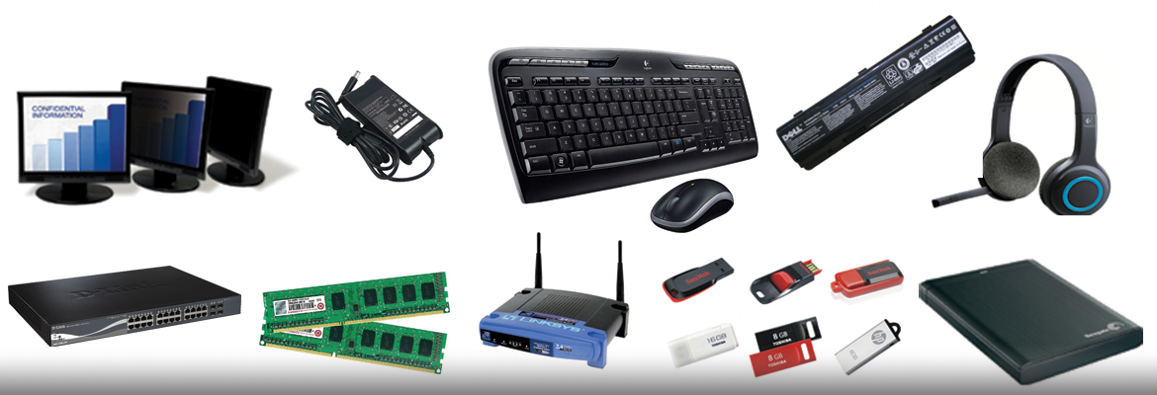
(1.2) Network topologies, hardware and software
1.2.2 Network hardware
A host is a device with an IP address that requests or provides networking resources to any other host or node on the network.
A node is a device that does not have an IP address but can generate, receive and transmit networking resources on the computer network.
A network interface is a hardware component that allows clients, servers, peripheral devices and other equipment to communicate across a network.
Peripheral devices are printers, scanners and other devices that provide resources to clients across a network.

Slide 11
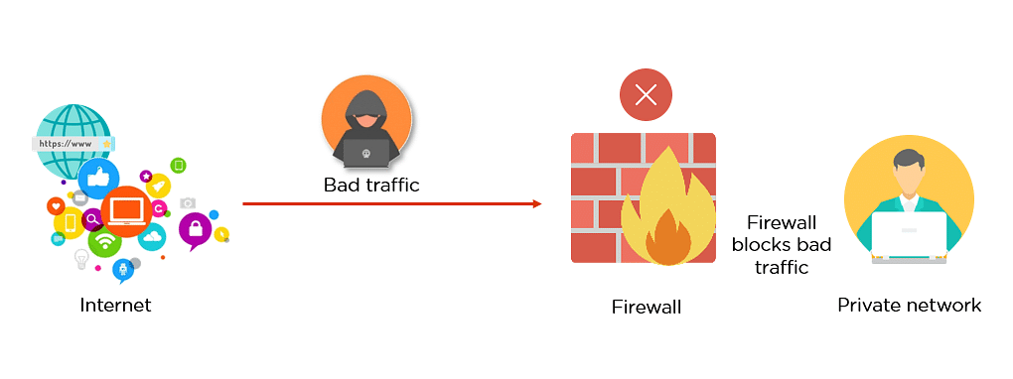
(1.2) Network topologies, hardware and software
Hubs and switches enable interconnection and communication between clients, servers and peripheral devices; routers direct data packets from a LAN to the Internet and vice versa.
A firewall monitors and controls incoming and outgoing network traffic, based on pre-configured security rules.
A wireless access point is a network device that enables access to the wired network for e.g. mobile devices.

Slide 12
(1.2) Network topologies, hardware and software
Activity
Study the following:
Descriptions of common network devices and their functions.
Link: https://blog.netwrix.com/2019/01/08/network-devices-explained/
Time allocation: 15 minutes

Slide 13
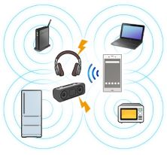
(1.2) Network topologies, hardware and software
The most common network transmission media are:
Twisted pair cable: used primarily in LANs.
Coaxial cable: popular for transferring data and video.
Fibre optic cable: used mainly in WANs, MANs, and for provision of fibre to the home (FTTH).
Infrared and Bluetooth: support wireless data transmission over short distances.
Radio waves: used by WANs to cover large areas.
Satellite transmission: utilises a wide spectrum of wavelengths and frequencies to support global telecommunication.

Slide 14

(1.2) Network topologies, hardware and software
NOS provides basic services like file and print sharing.
It also supports advanced services like web, mail, and database servers.
Examples include Windows Server, Linux Server, and macOS X Server.
Network surveillance monitors traffic for hacking or illegal activity.
Common network apps include email, video conferencing, and antivirus software.

Slide 15

(1.3) The functions performed by different types of servers on a network
1.3.1 What is a server?
A server is a computer (or a group of computers) that provides resources, data, services or application programs to other computers (known as clients) over a network.

Slide 16
(1.3) The functions performed by different types of servers on a network
1.3.2 The functions performed by different types of servers
File servers store files and share them with authorised users.
Print servers send files to specified printers and monitor the status of print jobs.
Application servers provide authorised users with access to centrally installed software applications.
Domain Name System (DNS) servers translate server names that are readable by humans into machine-readable IP addresses.

Slide 17
(1.3) The functions performed by different types of servers on a network
Mail servers send outgoing email messages originating from client computers, and forward incoming email messages to the specified users.
Web servers host applications and data that can be accessed by users via an intranet or over the Internet.
Database servers host database applications and share requested data with authorised users.
Monitoring and management servers monitor network traffic in order to ensure the smooth functioning of the network.

Slide 18
(1.3) The functions performed by different types of servers on a network
Activity
If you were setting up a small business network that included a file server, an email server, four PCs, a printer and a router, which topology would you use and why? Write down your answer and include a supporting diagram to illustrate your choice of topology.
Time allocation: 15 minutes

Slide 19
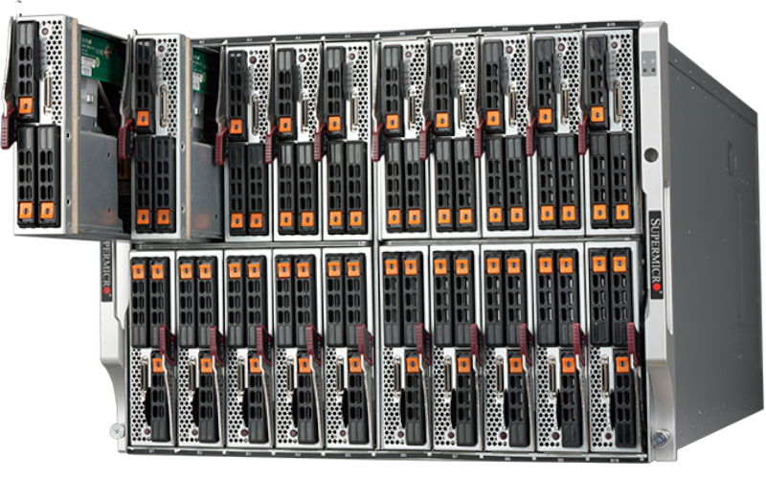
(1.3) The functions performed by different types of servers on a network
More recent server models include blade servers, which are smaller and easier to maintain than traditional servers; mirroring, which makes it possible to perform maintenance without shutting down the entire server; and virtual servers, where hardware and software are spread across multiple servers and storage devices.

Slide 20
(1.3) The functions performed by different types of servers on a network
Activity
Study the following:
The information provided in section 1.3 is based on online content available at:
Link: https://www.paessler.com/it-explained/server
Time allocation: 15 minutes

Slide 21
(1.4) The OSI model and the IEEE 802 standards
1.4.1 The OSI reference model
The OSI model is a theoretical framework for network communication.
It explains how data moves through different layers in a network.
The model has seven layers, each with a specific role.
Each layer prepares data for the next layer in the sequence.

Slide 22
(1.4) The OSI model and the IEEE 802 standards
Activity
Watch the following video:
Title: What is the OSI Model (Open Systems Interconnection Model)?
Link: https://www.youtube.com/watch?v=jlp8HL_iIqo
Discuss this with your fellow students and lecturer.
Time allocation: 02:06

Slide 23
(1.4) The OSI model and the IEEE 802 standards
Physical layer (Layer 1): This layer represents physical components such as network interface cards, and logical components such as network media and transmission speeds. In this layer, the Protocol Data Units (PDUs) are referred to as bits.
Data Link layer (Layer 2): This layer is responsible for assigning the physical protocols to be used for communication and preparing data for transmission via the Physical layer. In this layer, the PDUs are referred to as frames.
Network layer (Layer 3): This layer provides the routing mechanism between networks, based on logical elements such as IP addresses. In this layer, the PDUs are referred to as packets.

Slide 24
(1.4) The OSI model and the IEEE 802 standards
Transport layer (Layer 4): This layer is responsible for transporting data between network devices and adds reliability by controlling for errors. In this layer, the PDUs are referred to as segments.
Session layer (Layer 5): This layer manages and controls the synchronisation of data between applications. In this layer, the PDUs are referred to as data.
Presentation layer (Layer 6): This layer receives data from the application layer, and represents it in the desired format such as text, sound or video. This layer also provides security through encryption. In this layer, the PDUs are referred to as data.
Application layer (Layer 7): This layer is responsible for interacting with the operating system or application, to ensure that applications are able to utilise required network services. In this layer, the PDUs are referred to as data.

Slide 25
(1.4) The OSI model and the IEEE 802 standards
The Institute of Electrical and Electronics Engineers (IEEE) has developed a set of standards for PANs, LANs and MANs, which together are known as the IEEE 802 standards.
The services and protocols specified in IEEE 802 apply only to networks that carry variable-sized packets, and map to the physical layer and the data link layer of the OSI networking reference model.

Slide 26

(1.4) The OSI model and the IEEE 802 standards
1.4.2 The TCP/IP model
The Transmission Control Protocol/Internet Protocol (TCP/IP) model is a practical model that combines two communication protocols.
The TCP protocol ensures that the data being transmitted is reliable and correctly ordered, while the IP protocol forwards data packets from the source computer to the destination computer.

Slide 27
(1.4) The OSI model and the IEEE 802 standards
The actual communication process between two computers (PC1 and PC2) works as follows:
Application layer: If the user of PC1 uses a browser to access an Internet website, the Hypertext Transfer Protocol (HTTP) will process the request and forward the response to the transport layer.
Transport layer: The TCP protocol packages the data received from the HTTP protocol into segments called datagrams, before forwarding them to the Internet layer.
Internet layer: The IP protocol adds the source and destination IP addresses to the datagrams that have been received, at which stage they are referred to as packets. The packets are then transmitted to the network access layer.
Network access layer: The Ethernet protocols (which are mostly used in LANs) organise the data into frames by adding the source and destination MAC addresses. These frames are then carried over the network to their destination.

Slide 28
(1.4) The OSI model and the IEEE 802 standards
Activity
Watch the following videos:
Title: what is TCP/IP and OSI? // FREE CCNA // EP 3.
Link: https://www.youtube.com/watch?v=CRdL1PcherM
Time allocation: 12:03
Title: OSI and TCP IP Models - Best Explanation.
Link: https://www.youtube.com/watch?v=3b_TAYtzuho
Time allocation: 19:19

